Slide 1

RNS INSTITUTE OF TECHNOLOGY
BENGALURU - 98
DEPARTMENT OF INFORMATION SCIENCE & ENGINEERING
Presentation on Internship
Depression Detection using Tweets
Aarshabh Agrawal
USN: 1RN18IS001
New Age Solutions Technologies
Internal Guide
Dr. Suresh L
HOD, Dept of ISE, RNSIT
External Guide
Mr. Aman Upadhyay
Prof, Company-Nastech
Notes:
1

Slide 2
AGENDA
Abstract
About the Company
Introduction
Literature Survey
Requirements
System Design
Detailed Design
Implementation
Testing
Conclusion and Future Enhancements
References
Q & A
VIII Semester, Department of ISE, RNSIT
2021 - 2022
2

Slide 3
ABSTRACT
Detection of Depression from Twitter
Social networks have been developed as a great point for its users to communicate with their interested friends and share their opinions, photos, and videos reflecting their moods, feelings and sentiments. This creates an opportunity to analyze social network data for user’s feelings and sentiments to investigate their moods and attitudes when they are communicating via these online tools.
Although diagnosis of depression using social networks data has picked an established position globally, there are several dimensions that are yet to be detected. In this study, we aim to perform depression analysis on Twitter data collected from an online public source. To investigate the effect of depression detection, we propose machine learning technique as an efficient and scalable method.
VIII Semester, Department of ISE, RNSIT
2021 - 2022
3

Slide 4
About the Company
NASTECH is formed with the purpose of bridging the gap between Academia and Industry.
Nastech is one of the leading Global Certification and Training service providers for technical and management programs for educational institutions.
We collaborate with educational institutes to understand their requirements and form a strategy in consultation with all stakeholders to fulfill those by skilling , reskilling and upskilling the students and faculties on new age skills and technologies.
VIII Semester, Department of ISE, RNSIT
2021 - 2022
4

Slide 5
INTRODUCTION
The proliferations of internet and communication technologies, especially the online social networks have rejuvenated how people interact and communicate with each other electronically.
The applications such as Facebook, Twitter, Instagram and alike not only host the written and multimedia contents but also offer their users to express their feelings, emotions and sentiments about a topic, subject or an issue online.
On one hand, this is great for users of social networking site to openly and freely contribute and respond to any topic online; on the other hand, it creates opportunities for people working in the health sector to get insight of what might be happening at mental state of someone who reacted to a topic in a specific manner.
VIII Semester, Department of ISE, RNSIT
2021 - 2022
5

Slide 6
Requirements
HARDWARE REQUIREMENTS:
Processor : Pentium 4 and above
Processor Speed : 2.4 GHz
RAM : 1GB
Storage Space : 40GB
Monitor : 1024x768 or 1280x1024
SOFTWARE REQUIREMENTS:
IDE : Jupyter Notebook/Google Colab
Interpreter : Python 3
VIII Semester, Department of ISE, RNSIT
2021 - 2022
6

Slide 7
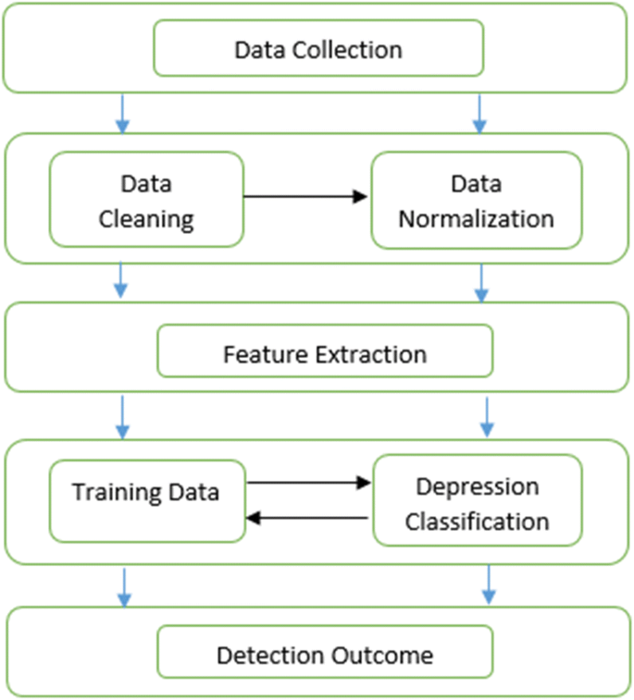
System Design
VIII Semester, Department of ISE, RNSIT
2021 - 2022
7
Notes:
7

Slide 8
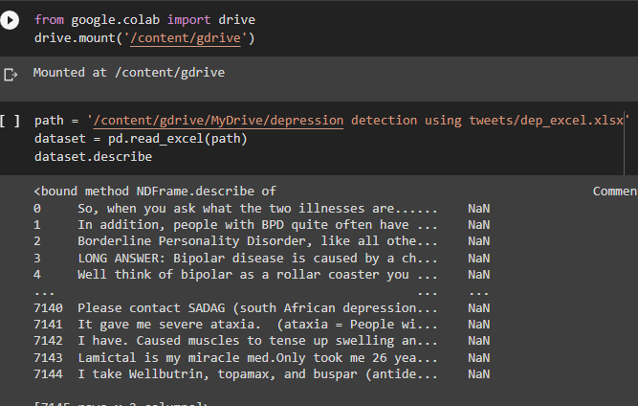
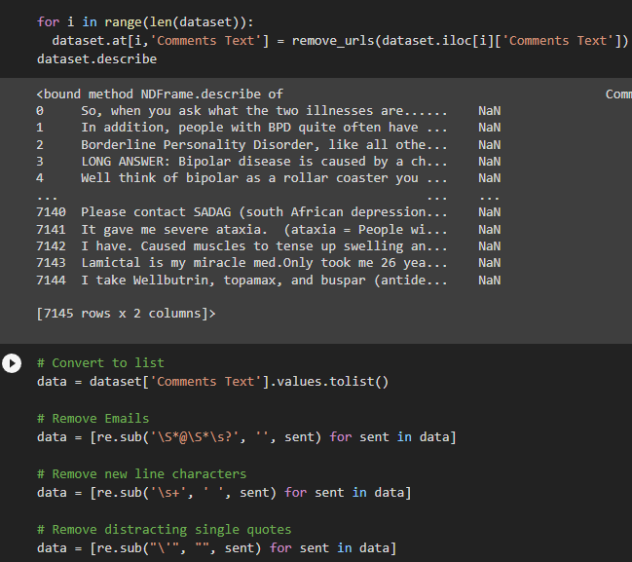
Implementation / Coding
VIII Semester, Department of ISE, RNSIT
2021 - 2022
8
Notes:
8

Slide 9
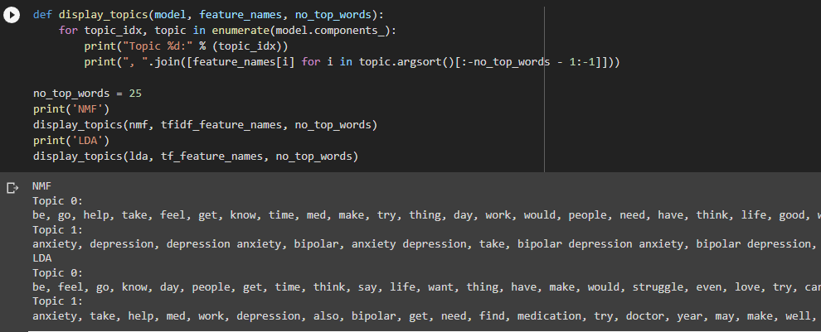
Implementation / Coding
VIII Semester, Department of ISE, RNSIT
2021 - 2022
9
Notes:
9

Slide 10
Implementation / Coding
VIII Semester, Department of ISE, RNSIT
2021 - 2022
10
Notes:
10

Slide 11
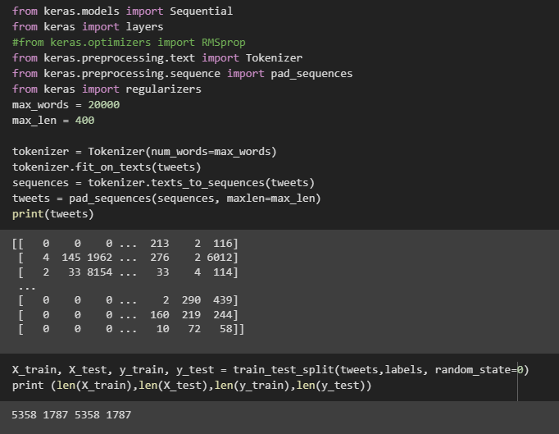
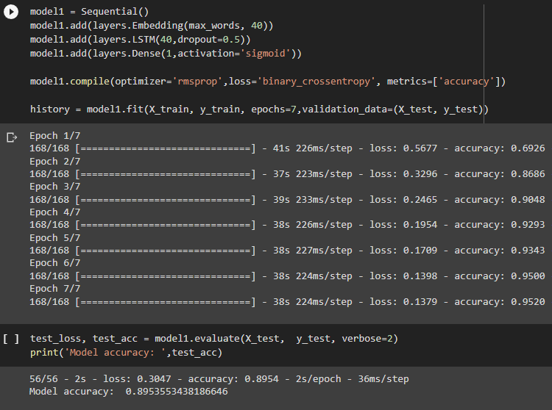
Implementation/Coding
Model training
VIII Semester, Department of ISE, RNSIT
2021 - 2022
11
Notes:
11

Slide 12
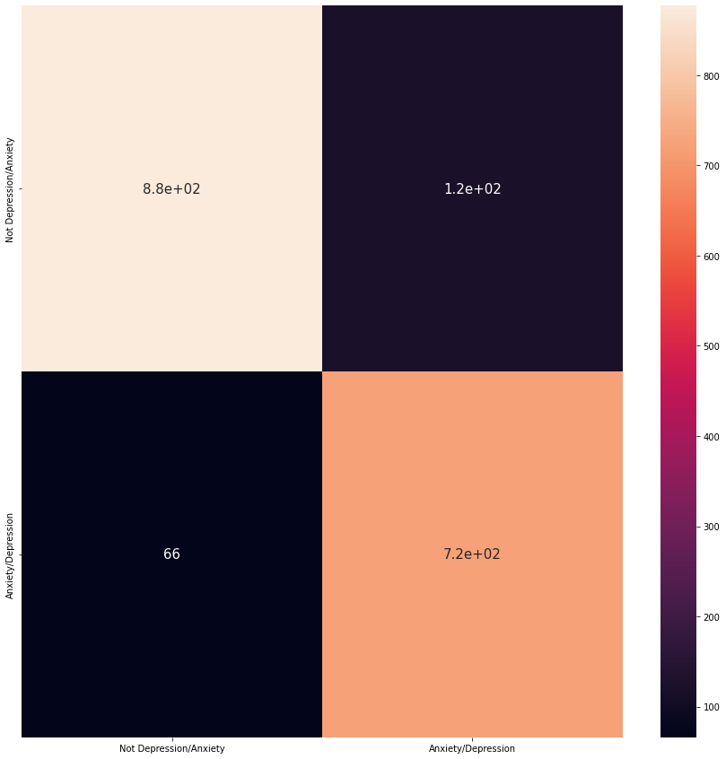
Implementation/Coding
VIII Semester, Department of ISE, RNSIT
2021 - 2022
12
Notes:
12

Slide 13
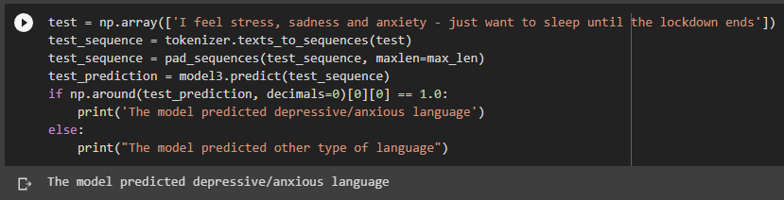
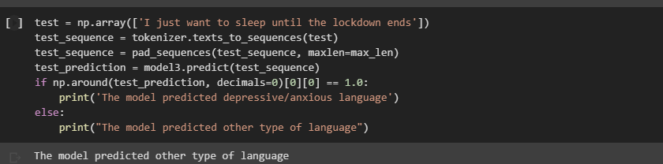
Result
VIII Semester, Department of ISE, RNSIT
2021 - 2022
13
Notes:
13

Slide 14
CONCLUSIONS
We went through several steps, including Natural Language Processing for clustering and classification. The main point to highlight is that Deep Learning is an approach for when you have tons of data available, otherwise most of the times regular/classic ML models would perform better.
As it is showcased from the project, Deep Learning this time delivered an acceptable score, but for any other task such as in medical field, definitely you will need to get more data to increase the recall score.
VIII Semester, Department of ISE, RNSIT
2021 - 2022
14
Notes:
14

Slide 15
Future Enhancements
Make use of Tweepy an open source tool used to scrap data from Twitter without using it’s API.
Make a Twitter Bot to autonomously reply to depressive tweets to find them get some helpline.
Make it applicable to variety of different social media apps in general such as facebook, instagram, reddit.
We can enhance this project which may take videos and images as the data-set.
VIII Semester, Department of ISE, RNSIT
2021 - 2022
15
Notes:
15

Slide 16
REFERENCES
Links:
1)https://www.kaggle.com/sergiovirahonda/depression-and-anxiety-comments
2)https://www.kaggle.com/sergiovirahonda/depression-anxiety-tweets
3)https://link.springer.com/article/10.1007/s13755-018-0046-0
4)https://en.wikipedia.org/wiki/Recurrent_neural_network
5)https://en.wikipedia.org/wiki/Long_short-term_memory
Books:
1)Introduction to Machine Learning with Python: A Guide for Data Scientists, by Sarah Guido & Andreas C. Mueller.
2)Hands-on Machine Learning with Scikit-Learn, Keras, and TensorFlow: Concepts.
3)Mathematics for Machine Learning, by Marc Peter Deisenroth.
VIII Semester, Department of ISE, RNSIT
2021 - 2022
16

Slide 17
Question and Answer
VIII Semester, Department of ISE, RNSIT
2021 - 2022
17

Slide 18
THANK YOU
VIII Semester, Department of ISE, RNSIT
2021 - 2022
18

